Slide 1
Programming Fundamentals
By
Shazmeen Batool

Slide 2
Previous Lecture
The relationship between array and pointers
Pointers Arithmetic

Slide 3
Today’s Lecture
Reference Variable
Double Pointers
Dynamic Memory Allocation

Slide 4
Reference Variables

Slide 5
Reference Variables
Imagine you have a real object, like a toy car, and you give it a nickname or an extra label. In C++, a reference variable is like that extra label – it's not a copy of the object, but another way to refer to the exact same thing.
A reference is declared using the & symbol and must be tied to an existing variable right when you create it (you can't make a reference without something to point to).
Once created, the reference acts as an alias: any changes you make using the reference directly affect the original variable, and vice versa.

Slide 6
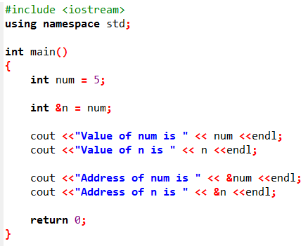


Slide 7
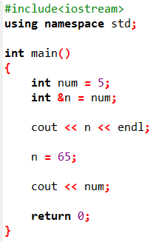

What is the output?

Slide 8
Difference b/w Pointer and Reference Variables
Pointers | Reference Variables
It is not necessary to initialize it with a value during declaration. | It is necessary to initialize it with a value during declaration.
It can be assigned a NULL value. | It cannot be NULL.
After declaration, it can be re-assigned to any other variable of the same type. | It cannot be re-assigned to any other variable after its initialization.

Slide 9
Double Pointers

Slide 10
Double Pointers
Imagine you have a box that contains a note with directions to another box. The first box is like a pointer (it points to something), and the second box is what it points to.
Now, what if you have a pointer that points to another pointer? That's a double pointer (or "pointer to a pointer") – it's like a box that holds directions to a box that holds directions to the actual thing.

Slide 11
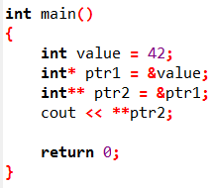

Double Pointers
In C++, a double pointer is declared with two asterisks (**), like int** ptr;. It points to a memory address that holds another pointer, which then points to the actual data (like an integer).

Slide 12
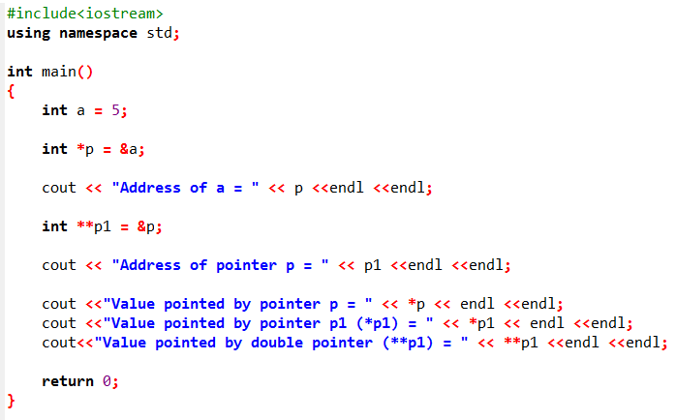

Slide 13
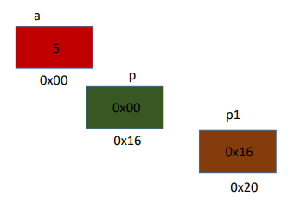
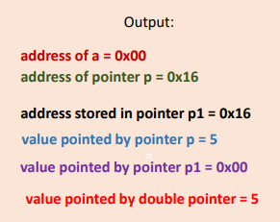
Double Pointers

Slide 14
Double Pointers
Single pointer (*): Points directly to data.
Double pointer (**): Points to a pointer, which points to data. You need to dereference twice (with **) to access the value.
They're useful for things like dynamic arrays, 2D arrays, or functions that modify pointers (e.g., in linked lists or when passing pointers by reference).
Think of it as a "chain of directions": Follow the first pointer to find the second, then follow that to the treasure. If you mess up the chain, you might get lost in memory! Always initialize them to avoid errors.

Slide 15
Dynamic Memory Allocation

Slide 16
Dynamic Memory Allocation
You can control the allocation and deallocation of memory in a program for objects and for arrays of any built-in or user-defined type.
To dynamically allocate memory means that a program, while running, asks the computer to set aside a chunk of unused memory large enough to hold a variable of a specific data type.

Slide 17
Dynamic Memory Allocation
Imagine your program is like a house with a fixed number of rooms (memory) built in. But sometimes, you need extra space for guests or stuff that shows up later – you can't predict it ahead of time. Dynamic memory allocation in C++ lets you "build" extra rooms (memory) while the program is running, using tools like new and delete.

Slide 18
Dynamic Memory Allocation
Let’s say a program needs to create an integer variable. It will make a request to the computer that it allocate enough bytes to store an int. When the computer fills this request, it finds and sets aside a chunk of unused memory large enough for the variable. It then gives the program the starting address of the chunk of memory. The program can only access the newly allocated memory through its address, so a pointer is required to use those bytes.

Slide 19
Dynamic Memory Allocation
The way a C++ program requests dynamically allocated memory is through the new operator.
You can use the new operator to dynamically allocate (i.e., reserve) the exact amount of memory required to hold an object or built-in array at execution time.
The object or built-in array is created in the free store (also called the heap)—a region of memory assigned to each program for storing dynamically allocated objects.
Once memory is allocated in the free store, you can access it via the pointer that operator new returns.

Slide 20
Dynamic Memory Allocation
When you no longer need the memory, you can return it to the free store by using the delete operator to deallocate (i.e., release) the memory, which can then be reused by future new operations.

Slide 21
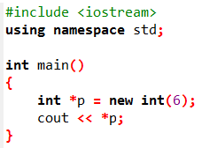
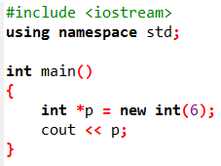

Dynamic Memory Allocation

Slide 22
Dynamic Memory Allocation
If new is unable to find sufficient space in memory for the variable, it indicates that an error occurred by throwing an exception.
In C++, the delete operator is used to release (or deallocate) memory that was previously allocated dynamically using new.

Slide 23
Dynamic Memory Allocation
Not releasing dynamically allocated memory when it’s no longer needed can cause the system to run out of memory prematurely. This is sometimes called a “memory leak.”
Do not delete memory that was not allocated by new. Doing so results in undefined behavior.

Slide 24
Dynamic Memory Allocation
You can provide an initializer for a newly created fundamental-type variable, as in

Slide 25

Dynamically Allocating Built-In Arrays with new[ ]
You can also use the new operator to allocate built-in arrays dynamically. For example, a 10-element integer array can be allocated and assigned to gradesArray as follows:
which declares int pointer gradesArray and assigns to it a pointer to the first element of a dynamically allocated 10-element array of ints.

Slide 26
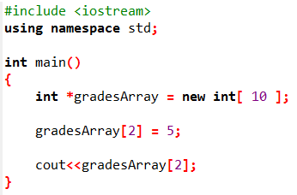
Dynamically Allocating Built-In Arrays with new[ ]

Slide 27
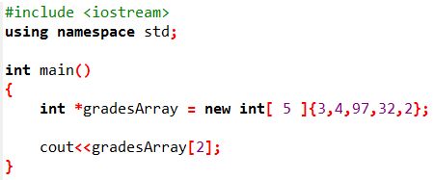
Dynamically Allocating Built-In Arrays with new[ ]

Slide 28
Releasing Dynamically Allocated Built-In Arrays with delete []
To deallocate the memory to which gradesArray points, use the statement

Slide 29
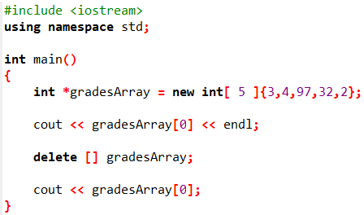

Releasing Dynamically Allocated Built-In Arrays with delete []

Slide 30
Next Lecture
Functions

